Slide 1

SALT ‘N PEPPER
SANJAY K A
SHARATH N
SARFARAZ MALIK
ABHISHEK
AN ONLINE FOOD ORDERING WEBSITE.

Slide 2
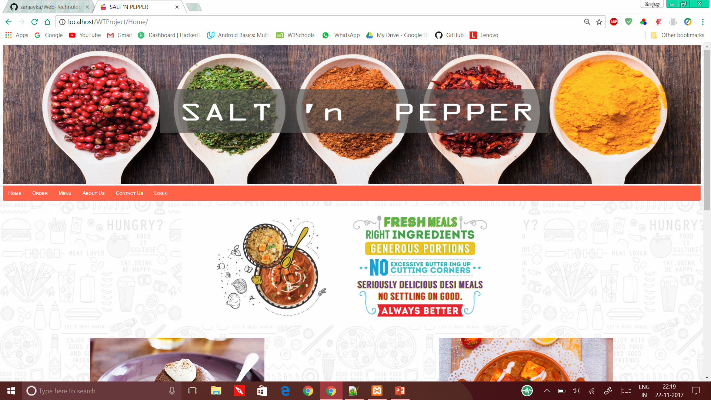
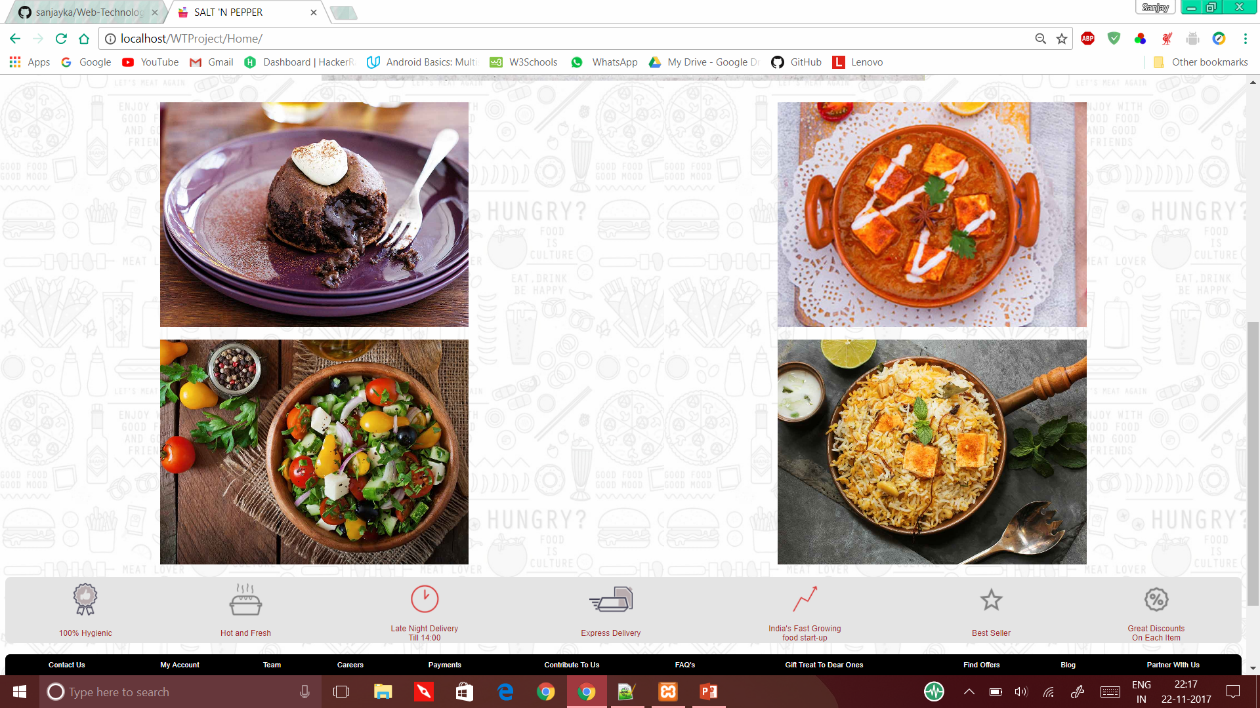
ABOUT THE WEBSITE.

Slide 3
ABOUT THE WEBSITE
SALT ‘N PEPPER is an online food ordering website.
You can order food from the variety of menu available , along with the doorstep delivery.
The website mainly consists of :
A Homepage
Different MENU pages
The order page ( CART)
Login page
About and Contact page

Slide 4
TECHNOLOGY USED
The website was built mainly with the usage of HTML , CSS , JAVA-SCRIPT and PHP.
One of the major feature , is the implementation of CART system.
It also uses files for keeping track of orders.

Slide 5
Elements in the page.
Along with the basic HTML tags, we have numerous other tags, numerous functions in Javascript, humongous amount of coding in PHP, file handling in PHP.
Some of the extensively used tags in our webpage consists of <table>, <a>, <div>, <img> and <style>.
When it comes to implementation of the webpage they all come in to a single picture and enhane the perspective of the webpage.

Slide 6
Java Script
A webpage is qualified not only based on the styling, tags, etc., but also on the mutual interaction of the user and the browser.To achieve this, Javascript comes into picture.
Our webpage mainly uses “onclick events” everywhere to simply navigate, choose items around pages.And mainly with the help of “DOM” we validate the “login credentials”, link our PHP, etc.

Slide 7
PHP
Our webpage mainly deals with file handling(FH) concept for item selection which is not possible in javascript.Item selection not only requires FH but also makes use of “super global array” for transferring the items around the pages.
This php implementation deals with arrays and few of its operations such as concatenation, append, etc.

Slide 8
SPECIAL / KEY ASPECTS USED IN THE PROJECT.
Smooth Flow/hassle free transfer of control among webpages.
Visual treat to the customer not only by seeing the food items but also by the creative design of interactivity, visual carasoul of images everywhere around.
Smart “current active menu selection” on each of the food categories makes user order for more.
Appropriate use of PHP in the Cart System which is used to select items and calculate their prices not only from one particular category but all he wishes at once.
Usage of File Handling in the transfer of “customer selected items ” from .html to .txt with help of php and vice-versa.

Slide 9
FUTURE ENHANCEMENTS
Our objective is to accomplish the following features:
Keeping track of each user’s orders , so as to keep track of the user’s diet and to assist him .
Make our food available not only for residents , but also for travellers travelling by BUS , TRAIN or a FLIGHT.
Real-Time navigation of the delivery system.
Avail an app in the app-store.

